Slide 1



Team Leader : Mr.Rahul Tetwar Team Member 1 : Mr. Pranjal Jadhav Team Member 2 : Mrs. Akankasha Kasar Team Member 3 : Mr. Govind Ambade Team Member 4 : Mr. Prajwal Chapke Team Member 5 : Mr. Vedant Koleshwar
Team Name : EcoWarriors

Slide 2


Slide 3
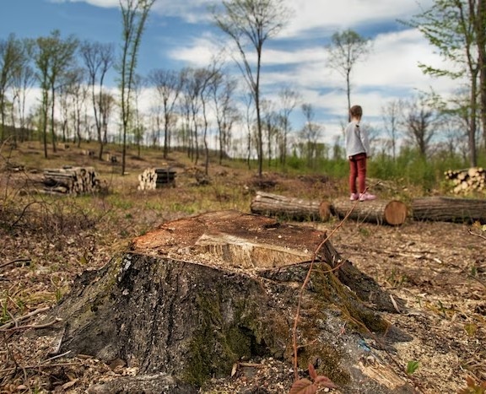
PROBLEM :
Application of Image Analytics for Tree enumeration for diversion of Forest Land.
PS Number : SIH1316

Slide 4
INTRODUCTION :
Vital Importance : Assessing and monitoring Earth's surface is vital.
Basis for Life : Vegetation mapping is crucial for natural resource management and forms the foundation for all life.
Climate Impact : It significantly impacts global climate change dynamics.
Continuous Monitoring : Facilitates continuous monitoring of Earth's surface.
Application of Image Analytics
Tree Enumeration
Diversion of Forest Land

Slide 5
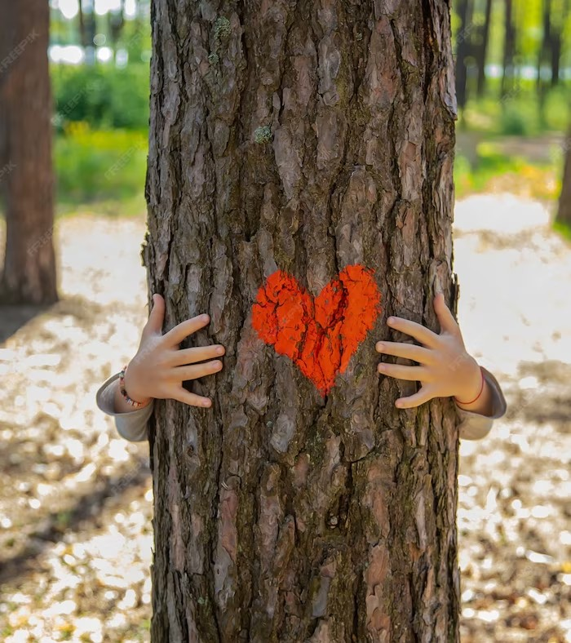
OBJECTIVES :
Image Data Analysis.
Counting and Categorization.
Accuracy and Validation.
Scalability and Efficiency.
Integration and Visualization.
Ethical and Environmental Considerations.
Reduce Deforestation & Global Warming.
Reduce Cost & Man-Power.

Slide 6
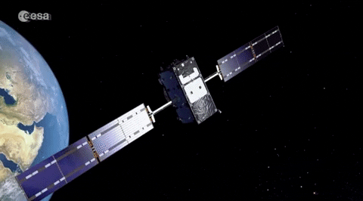
SOLUTIONS :
We can develop websites for :
Counting Trees
Categorization of Trees
Area covered by forest land
Tree Analysis
Technology To Be Used :
Machine Learning and AI
Programming Languages : Python
Mathematical Software: Matlab
Data Preprocessing Tools : Pandas (Python)

Slide 7
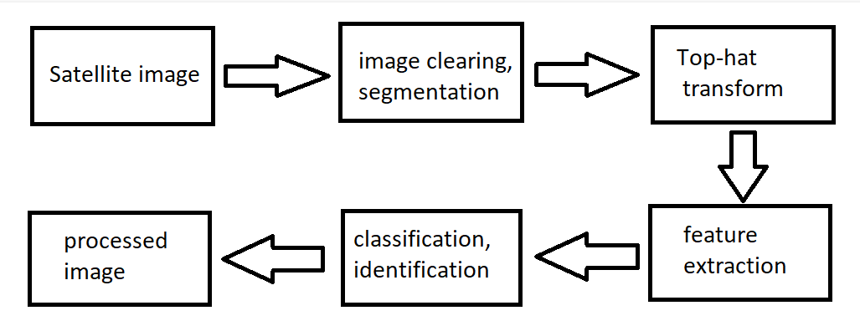
METHODOLOGY :

Slide 8
FOLLOWING ARE THE STEPS :
Input Satellite Image: Download high-resolution satellite images from sources like Google Earth, ISRO, or NASA.
Image Cleaning and Segmentation: Reduce image noise and segment it into distinct regions or objects to simplify analysis.
Top-Hat Transform: Extract small details and elements from the image.
Feature Extraction: Divide and reduce raw data into manageable groups for easier processing.
Classification and Identification: Categorize and label image components based on predefined rules, including object identification.
Processed Image: Obtain the final processed image after completing the above steps.

Slide 9
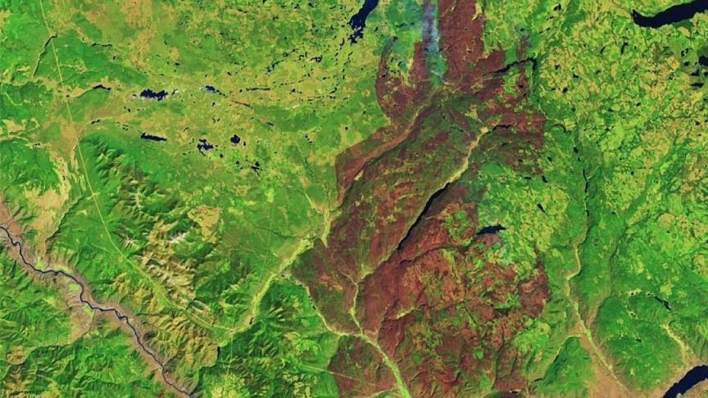
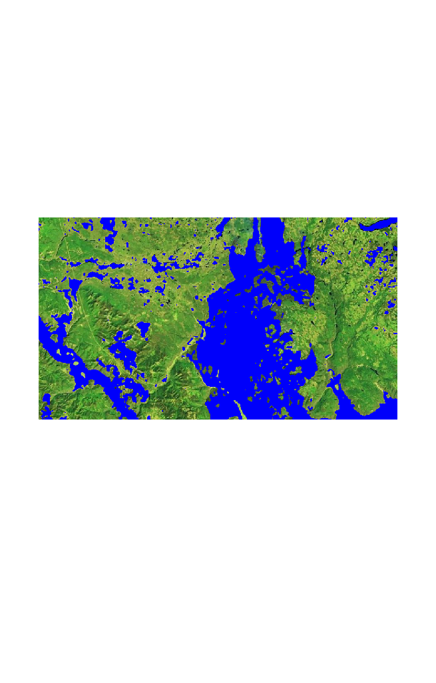
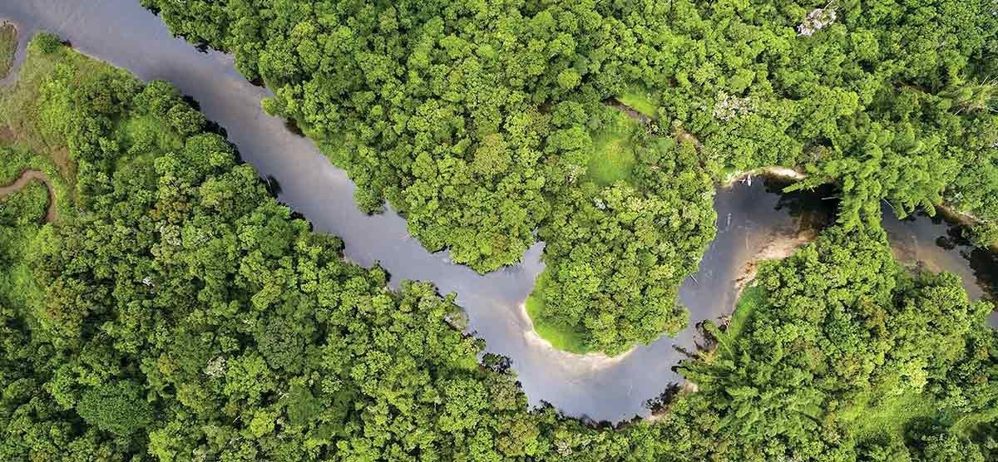
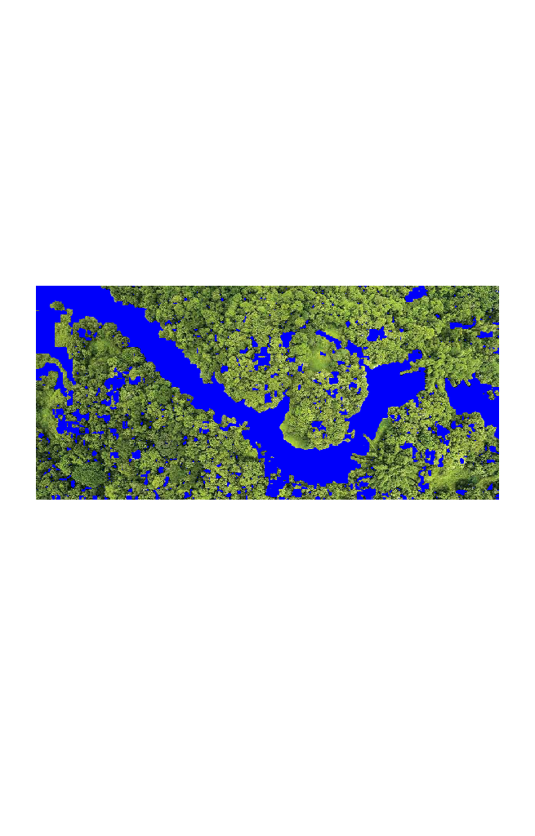
Before Process
After Processed

Slide 10
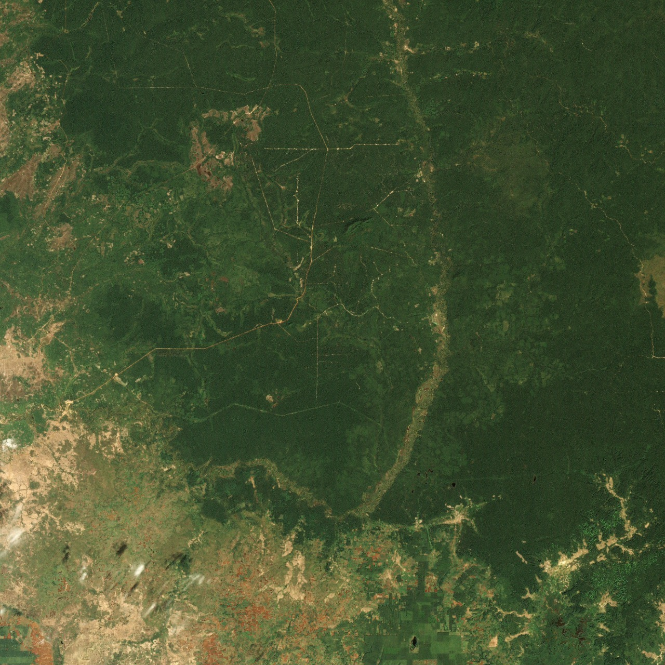
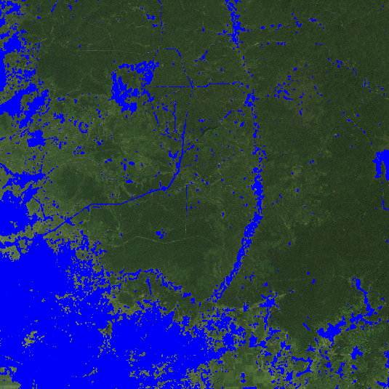
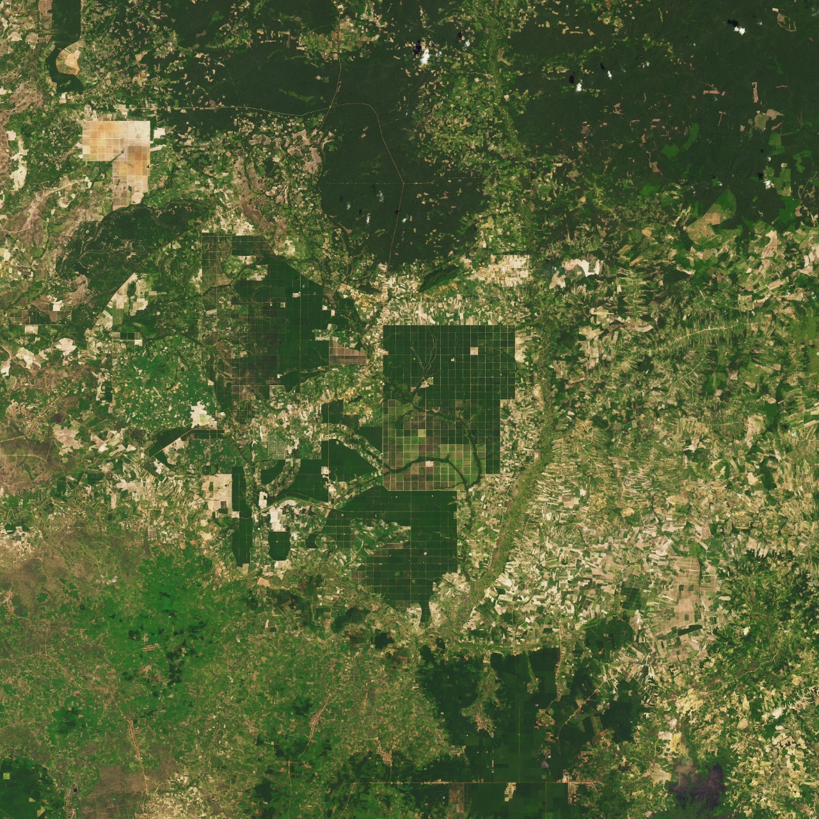
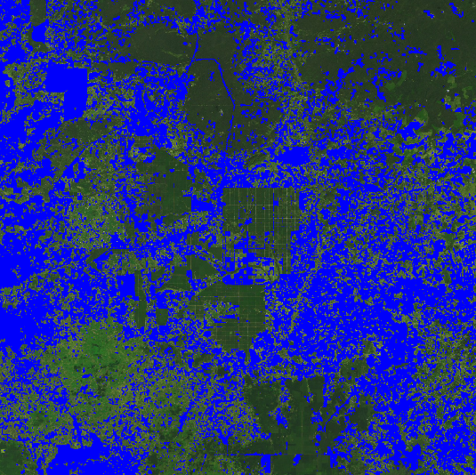
Fig 1: Cambodia’s Forests satellite image in Dec 2000
Fig 2: Satellite image after processed image.
Fig 3: Cambodia’s Forests satellite image in Oct 2015
Fig 4: Satellite image after processed image

Slide 11

FUTURE SCOPES :
This websites can be helpful in decision making for government.
Towards the Agriculture Sector
Reduces Deforestation
Good source for classification or identification of area.
Monitoring and Mapping in Region.
Data Collection and Analysis.

Slide 12
REFERENCES :
1) Image Source : Earth Observatory Satellite of NASA.
2) “ Remote sensing imagery in vegetation mapping ”, Jounal of Plant Ecology
3) “ Supervised Classification of Satellite images ”, IEEE 2016 Conference on Advances in Signal Processing.
4) “ Vegetation change detection using remote sensing and gis-A case study of Vellore District. ”

Slide 13


